Slide 1

Detection of cyberattacks
Project members: Mahmoud Ibrahim El-Molla 224417
Hisham Ahmed Refaat 221035
Youssef Ahmed Hany 220427
Ali Mohamed Hassan 221383
Undersupervison : Dr.Ahmed

Slide 2

Brief introduction
Detecting cyber attacks is a critical aspect of modern cybersecurity, involving the use of sophisticated technologies and human expertise to identify malicious activities within digital networks. Through a combination of automated systems, such as intrusion detection and prevention systems, and human analysis, organizations can proactively monitor for anomalies, identify potential threats, and respond swiftly to mitigate risks. This brief introduction highlights the collaborative efforts required to stay ahead of evolving cyber threats in today's digital landscape

Slide 3
Types of cyber attacks
1. Malware
2. Denial-of-Service (DoS) Attacks
3. Phishing Attempts
4. Intrusion

Slide 4
1. Malware (Malicious Software)
Description:
Malware refers to any type of software intentionally designed to cause damage to a computer, server, network, or device.
Common types of malware include viruses, worms, Trojans, ransomware, spyware, adware, and rootkits.
Malware can steal sensitive information, disrupt normal operations, compromise system security, and cause financial or reputational harm.
Malware is often distributed through email attachments, malicious websites, infected software downloads, or removable media.
Types:
Viruses: Malicious code that attaches itself to legitimate programs and spreads when these programs are executed.
Worms: Self-replicating malware that spreads across networks without user intervention, exploiting vulnerabilities in system security.
Trojans: Malware disguised as legitimate software, often used to create backdoors for unauthorized access or to steal sensitive information.
Spyware: Malware designed to monitor user activities, gather sensitive information, and transmit it to unauthorized parties.
Adware: Malware that displays unwanted advertisements or redirects web traffic to generate revenue for the attacker.
Problems:
Malware attacks can often lead to data loss and system disruptions. what are you supposed to do to overcome a data backup & Recovery
Solution:
Develop a disaster recovery plan outlining steps for restoring compromised systems and data.
Regularly test backup procedures to ensure they function correctly in case of a malware attack.

Slide 5
2. Denial of Service Attack
Description:
A Denial of Service (DoS) attack is a malicious cyberattack aimed at disrupting or degrading the availability of a targeted system, service, or network resource. The primary objective of a DoS attack is to overwhelm the target with a high volume of illegitimate traffic or resource requests, causing it to become unresponsive or unavailable to handle legitimate requests.
Problem:
An e-commerce website is experiencing a sudden surge in traffic, overwhelming its web server with a high volume of HTTP requests. As a result, legitimate users are unable to access the website, and the server becomes unresponsive. The website's availability and reputation are at risk, and the organization is losing potential sales and customer trust.
Solution:
DDoS Protection Services
Consider leveraging cloud-based DDoS protection services offered by internet service providers (ISPs) or specialized security vendors.
These services use advanced traffic analysis, anomaly detection, and mitigation techniques to detect and mitigate large-scale DDoS attacks in real-time, helping to maintain website availability and mitigate the impact of HTTP flood attacks.

Slide 6
3.Phishing attempts
Types of attempts:
1-Deceptive Communication: Phishing attempts employ tactics like email spoofing or social engineering to appear as legitimate communications from trusted sources.
2-Information Theft: The primary goal of phishing attacks is to harvest sensitive information, which can be used for identity theft, financial fraud, or unauthorized access to accounts.
3-Common Targets: Individuals, businesses, and organizations of all sizes are potential targets of phishing attempts, with attackers often exploiting human vulnerabilities and trust relationships.
4-Mitigation Strategies: Preventive measures include security awareness training, email filtering, multi-factor authentication, and the use of security software to detect and block phishing attempts.

Slide 7
Phishing attempts Cont.
Problem: A company's employees frequently receive phishing emails impersonating well-known financial institutions, urging them to click on links and provide their account credentials. Despite security awareness training, some employees continue to fall victim to these phishing attempts, putting the company's sensitive data at risk of unauthorized access and potential financial loss.
Solution:
Enhanced Email Filtering:
Upgrade the company's email filtering system to employ advanced threat detection algorithms capable of identifying and blocking phishing emails in real-time.
Configure the email filter to analyze incoming messages for phishing indicators, such as suspicious sender addresses, misspelled domain names, and embedded malicious links.
Simulated Phishing Exercises:
Conduct simulated phishing exercises to assess employees' susceptibility to phishing attacks and reinforce security awareness training.
Send simulated phishing emails to employees with varying levels of sophistication to gauge their responses and provide targeted training based on their performance..

Slide 8
4.Intrusion
Description:
In the context of cybersecurity, an intrusion refers to unauthorized access to a computer system, network, or data.
Intrusions can be perpetrated by hackers, malicious insiders, or automated attack tools.
The goal of an intrusion may vary, including data theft, system manipulation, sabotage, espionage, or disruption of services.
Intrusions can take various forms, such as exploiting software vulnerabilities, brute-force attacks, social engineering, or insider threats.
Intrusion detection systems (IDS) and intrusion prevention systems (IPS) are commonly used to detect and mitigate unauthorized access attempts.
Problem:
A ransomware attack occurs when malicious software encrypts the victim's files or entire system, rendering them inaccessible. The attacker then demands a ransom payment, typically in cryptocurrency, in exchange for decrypting the files or restoring access to the system. Ransomware attacks can be initiated through various means, including phishing emails, malicious downloads, or exploiting vulnerabilities in software or systems.

Slide 9
4.Intrusion Cont.
Solution:
1-Regular Data Backups: Implement a regular backup strategy for all critical data and systems. Ensure that backups are stored securely and are not directly accessible from the network to prevent them from being compromised during an attack. Regularly test the backup restoration process to ensure its effectiveness.
2-Patch and Update Systems: Keep all software and systems up to date with the latest security patches and updates. Vulnerabilities in outdated software are often exploited by ransomware attackers to gain access to systems. Employ automated patch management tools to streamline the process and reduce the risk of oversight.
3-Network Segmentation: Segment your network to limit the spread of ransomware in case of an infection. Isolate critical systems and sensitive data from less secure parts of the network. Implement firewalls and access controls to regulate traffic between network segments and prevent lateral movement by attackers.
4-Endpoint Protection: Deploy advanced endpoint protection solutions, such as next-generation antivirus software and endpoint detection and response (EDR) tools. These solutions can detect and block ransomware activity based on behavior analysis and threat intelligence, providing an additional layer of defense against attacks.
By implementing these proactive measures, organizations can better defend against ransomware attacks and minimize the impact of such cyber intrusions on their operations and data.

Slide 10
Detection of these attacks using ML
We can use machine learning models to detect patterns to apply to our system
We used a dataset with 25 feature and 40,000 record
Data preprocessing allow us to get precise results
In our research we used 3 machine learning model to get the best model to use in detection

Slide 11
Our Resources
Notebook we used : https://colab.research.google.com/drive/1d7VWNdPQLw_het5wOxi6bRPd_G343uEZ?usp=sharing
Dataset We used : https://www.kaggle.com/datasets/teamincribo/cyber-security-attacks

Slide 12
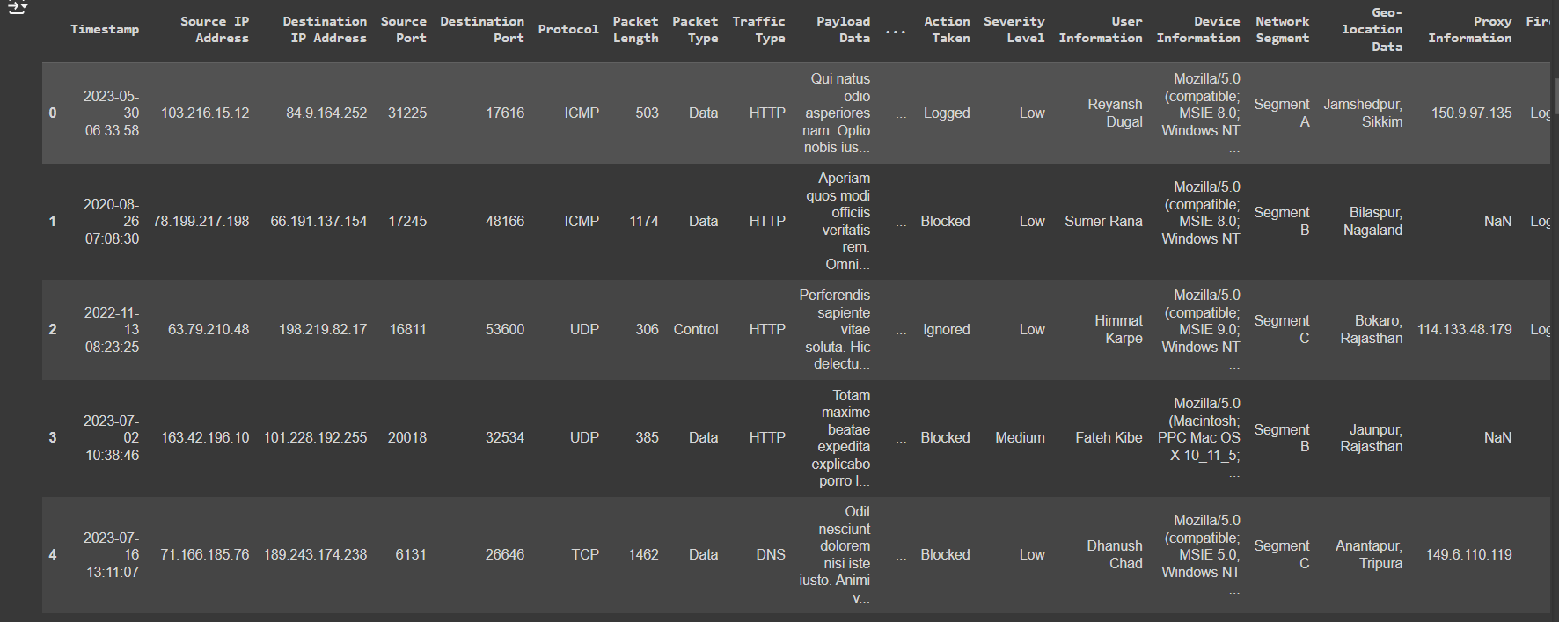
Dataset
Shape(40000,25)
Features : (Timestamp, Source IP Address, Destination IP Address, Source Port, Destination Port, Protocol, Packet Length, Packet Type, Traffic Type, Payload Data, Indicators, Anomaly Scores, False/Warnings , Attack Type, Attack Signature, Action Taken, Severity Level, User Information, Device, Information, Network Segment, Geo-location Data , Proxy Information Firewall Logs, IDS/IPS Alerts, Log Source )

Slide 13
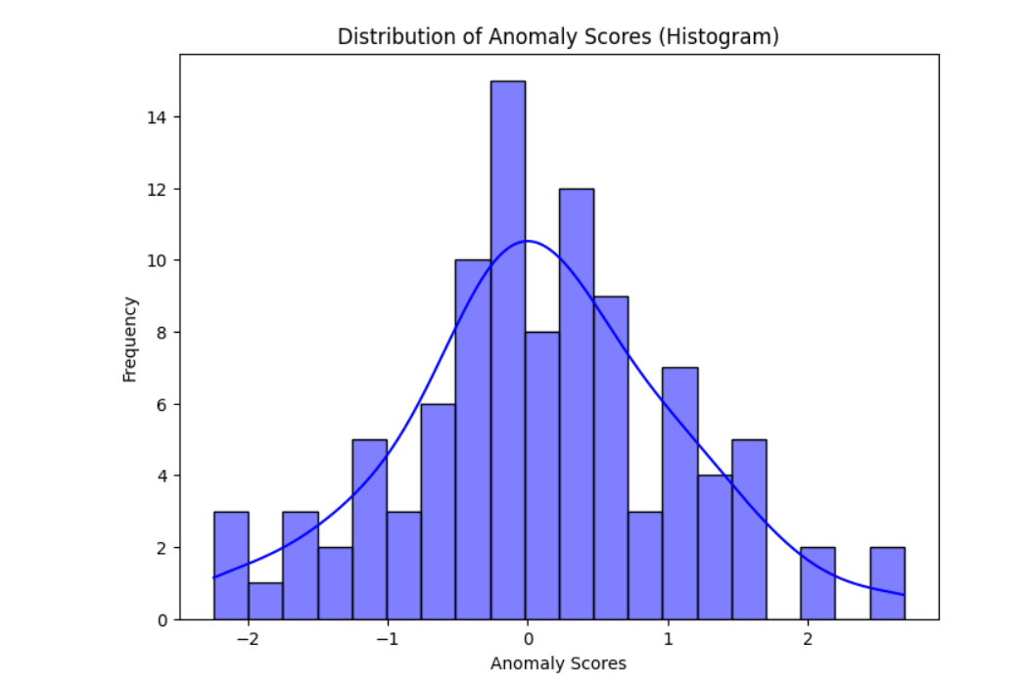
Statistical analysis and Data preprocessing
We did a bar chart for the anomaly Scores
We normalize the data by removing any null rows
We dropped 13 features as they were out of our scope ('Timestamp', 'Payload Data', 'Source Port', 'Destination Port', 'IDS/IPS Alerts', 'Source IP Address','Destination IP Address','User Information', 'Device Information','Geo-location Data', 'Firewall Logs', 'Proxy Information','Log Source’)

Slide 14
Train-Test-Split
We separate target value which is ‘Attack Type’.(“y = df["Attack Type"]”)
Then separate feature variables(“X = df.drop(["Attack Type"],axis=1)”)
Then we do Train-Test-Split 70% for training and 30% for testing ( “ X_train, X_test, y_train, y_test = train_test_split(X, y, test_size=0.3) ”)

Slide 15
Our models
Random Forest Regressor
Random Forest Classifier
Logistic Regression

Slide 16

Models Evaluation
Random Forest Regressor :
Score: 0.8435830500065526
Mean Squared Error: 232.4546273335677
Mean Absolute Error: 12.672871643060946
Random Forest Classifier :
Score: 0.946
Precision: 0.9569500239120038
Recall: 0.9520958083832335
Logistic Regression :
Score: 0.9733333333333334
Precision: 0.19488814317673378

Slide 17
Model Deployment
From our pervious evaluation we decide to deploy random forest classfier as our machine learning model.
Although Logistic regression was better in accuracy score with a 97.3%. The precision score was so far behind than the Random Forest model

Slide 18

Discussion
How can we deploy this model ?
Example : we can use it in detecting Dos attack from the patterns we discovered. we discovered that then a packet have larger length and the amount of packet of the same kind of protocol such as TCP send in short time period it lead to a Dos attack
So we can deny any of these patterns to happen in our network, to prevent future attacks
Finally, more research and testing need to done by other researchers , to achieve maximum results of detecting these attacks

Slide 19
Conclusion
In conclusion, detecting cyber attacks is essential in today's digital landscape, requiring a blend of advanced technology and human expertise. We explored various cyber threats, including malware, DoS attacks, phishing, and intrusions, highlighting their problems and proposed solutions like disaster recovery plans, DDoS protection services, enhanced email filtering, and robust backup strategies. Our research emphasized the use of machine learning models, specifically the Random Forest Classifier, for effective attack detection. Despite Logistic Regression achieving a higher accuracy, the Random Forest Classifier's superior precision makes it the preferred choice for deployment in identifying attack patterns and preventing future incidents. Continued research and testing are crucial to refining these detection methods and enhancing cybersecurity measures.

Slide 20
References
[1] I. Naseer, "Cyber Defense for Data Protection and Enhancing Cyber Security Networks for Military and Government Organizations," MZ Computing Journal, 2020. mzjournal.com
[2] D. Ghelani, T. K. Hua, and S. K. R. Koduru, "Cyber security threats, vulnerabilities, and security solutions models in banking," Authorea Preprints, 2022. authorea.com
[3] J. Chigada and R. Madzinga, "Cyberattacks and threats during COVID-19: A systematic literature review," South African Journal of Information, 2021. scielo.org.za

Slide 21
Thank you
.

